Slide 1
Music Genre Classification using Machine Learning
Group Members:
Wajiha Sahar
Sarah Anwar
Aeliya Sakeen

Slide 2
Introduction
Music Genres allow the categorization of music into broad groups of related songs for use in applications such as song recommender systems based on genre. Many existing songs are unlabeled, and new songs are constantly being released. While hand-labeling them all would be too tedious, classifying them by genre can fit them into categories for use in recommendation.
The main focus was to find appropriate methods that could
Best classify data with such a high dimensionality and
Reduce this high dimensionality and still retain the meaningful components of the data.

Slide 3
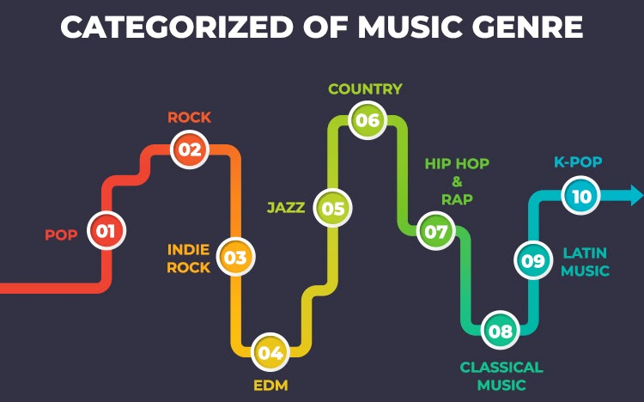
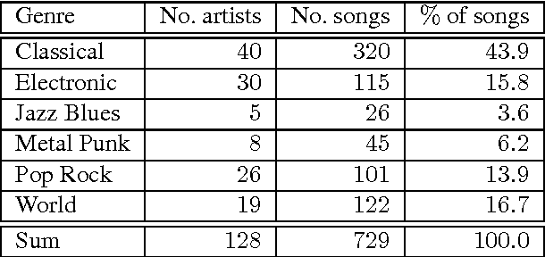
Problem solving:
Given a music audio, trying to tag it with one of the known genres ( Rock, Pop, classical, country, Jazz.. etc)
Use as little manual effort as possible, try to build models which can do this for us.

Slide 4
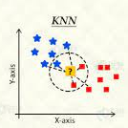
Algorithm used:
k-Nearest Neighbor: The k-nearest neighbor (kNN) classifier is a non-parametric classifier that polls the "k" nearest training points to a given test point and classifies that test point based on the majority vote of these "k" nearest neighbors. It can be shown that increasing the dimensionality of the data corresponds to decreasing the effectiveness of kNN - with increasing dimensionality, the "k" nearest neighbors to a given test point become increasingly less local to that test point.
Therefore, we implemented the Kullback-Leibler divergence as described in the “Distances” section to represent distance between two songs for kNN in addition to the standard Euclidean distance. We took 90% of the data as our training set and left 10% for testing.
Why knn:
Easy to handle
Determination of the amount of free K-parameters
and the selection of training data influences
the classification success percentage.
Easy to predict using data

Slide 5
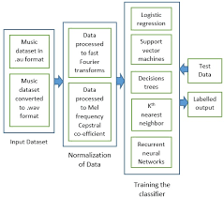
Dry run:

Slide 6
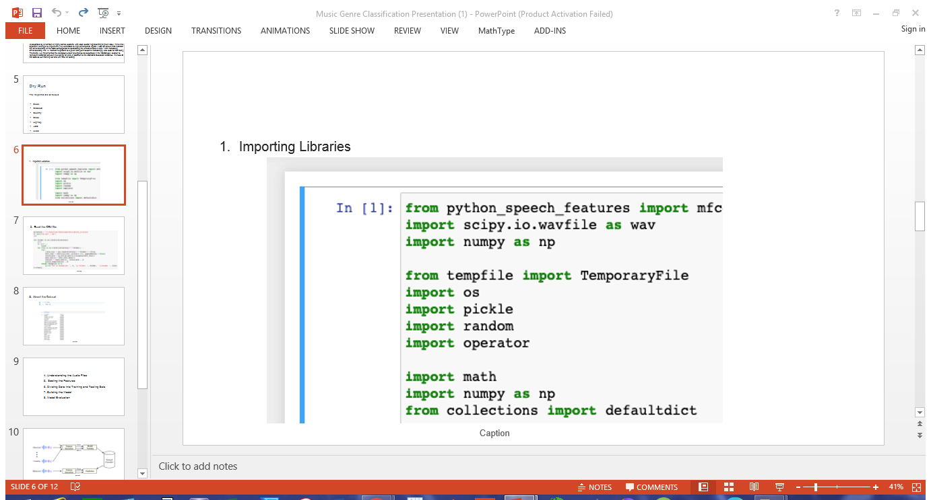
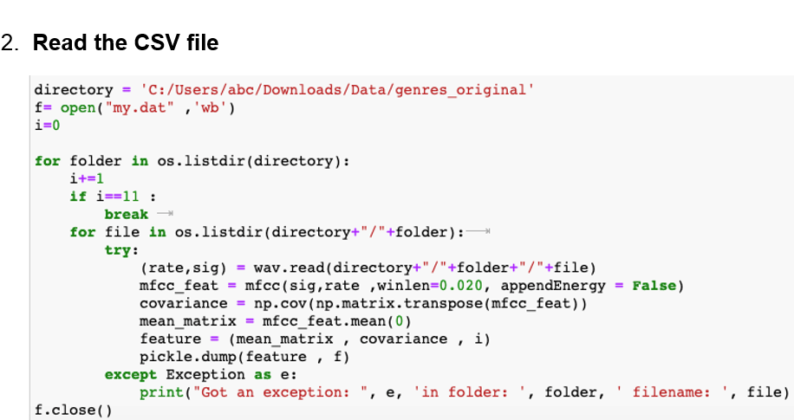
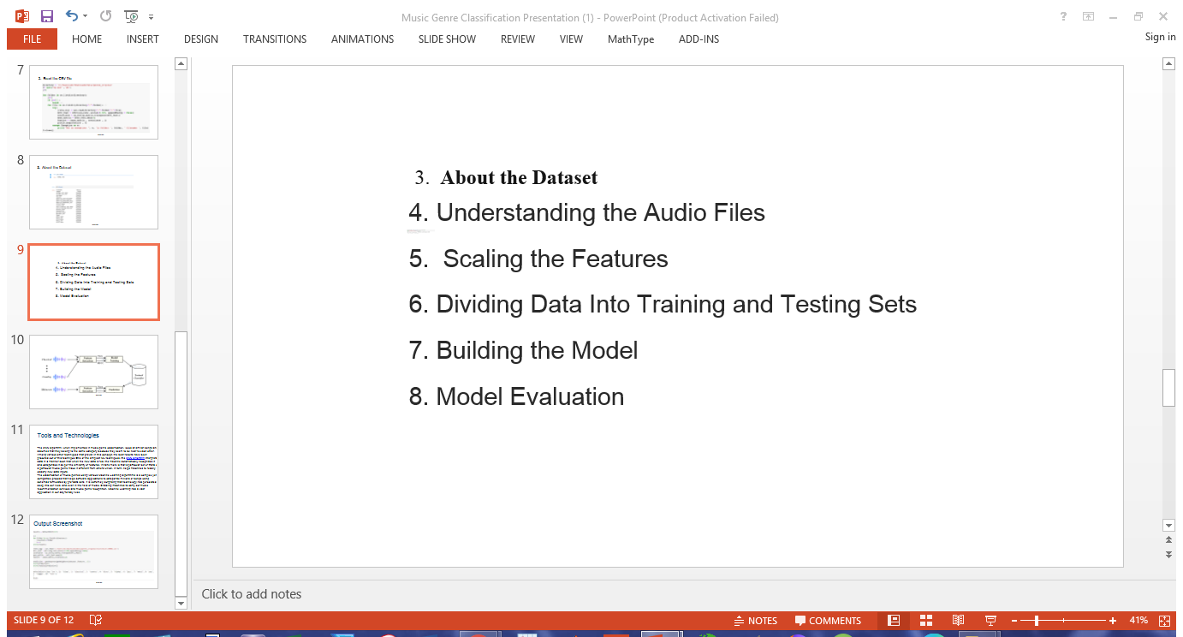

Slide 7
Tools:
LIBRARIES:
Librosa library for music analysis
Numpy for data cleansing and mathematical operations
Scipy for data handling and analysis
Temporary file for importing files
Python speech feature for feature extraction
The following steps to develop AI tool.
Identifying the problem.
Collecting and cleaning the data.
Converting the data so that it is ingestible for the ML algorithm.
Training the model.
Feature Engineering.
Evaluating and improving the model.
Serving the model to the clients.

Slide 8
Technologies:
The KNN algorithm, when implemented in music genre classification, looks at similar songs and assumes that they belong to the same category because they seem to be near to each other. Among various other techniques that prevail in this concept, the best results have been procured out of this technique.One of the simplest ML techniques, the KNN algorithm interprets data in a manner such that when the new data is fed, the machine automatically recognizes it and categorizes it as per the similarity of features. What's more is that a particular set of traits of a particular music genre make it different from others which, in turn, helps machines to readily classify new data inputs.
The classification of music genres using various Machine Learning algorithms is a complex yet compatible process that helps software applications to categorize millions of songs using schemas formulated by pre-data sets. It is extremely surprising that technology has percolated deep into our lives, and even in the field of music. Enabling machines to carry out music recommendation services and music genre recognition, Machine Learning has a vast application in our day-to-day lives.

Slide 9
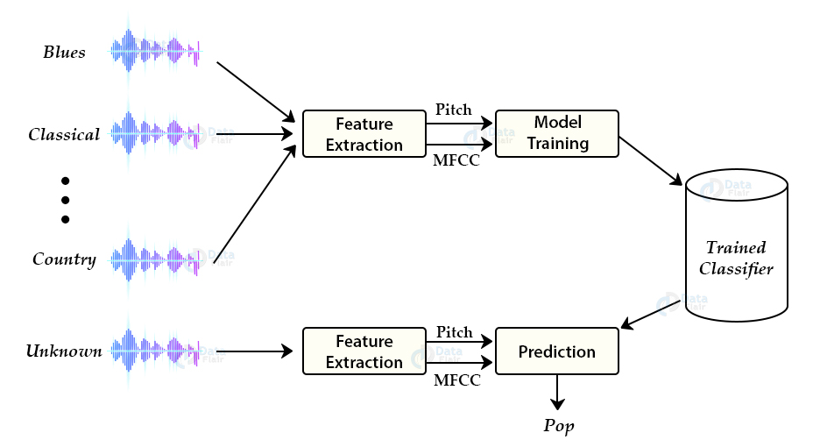
Our design:

Slide 10
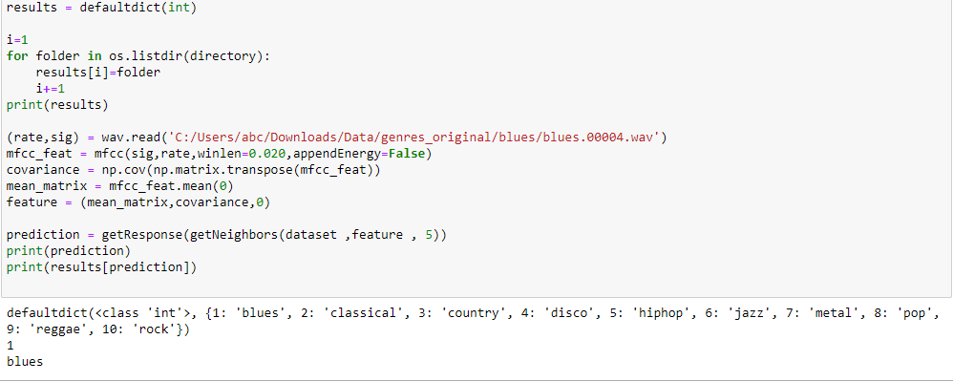
Output Screenshot

